Slide 1


SpendSense
Palak Saroop
300209805

Slide 2

Problem Statement
People struggle with:
Inconsistent expense tracking
Unexpected overspending
No predictive insights about spending
SpendSense helps by:
Automating spending predictions
Flagging overspending risk

Slide 3

Dataset Overview
Dataset: Spending Habits (Kaggle)
Features: Category, Payment Method, Amount, Date
Extracted Month & Year for seasonal pattern analysis

Slide 4

Machine Learning Models Used
Regression Model → Predicts next-month spending
Classification Model → Detects overspending risk
Label Encoders & Scalers used for preprocessing

Slide 5
System Workflow & Features
Workflow Steps:
User enters expense details
Data is encoded and scaled
Models generate predictions
Dashboard outputs results
Features:
Real-time prediction
Overspending alerts
Professional UI design

Slide 6
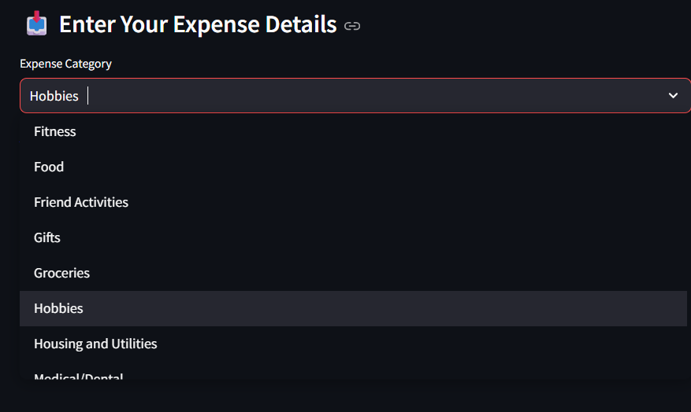
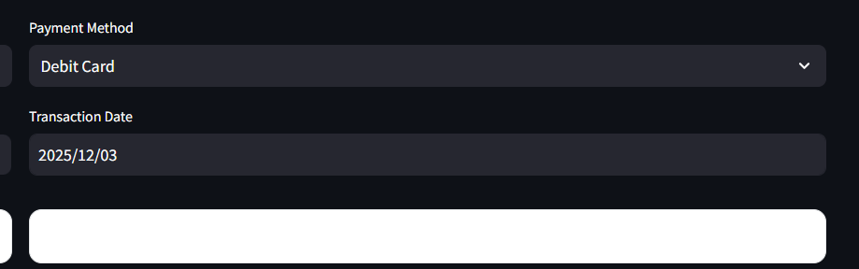
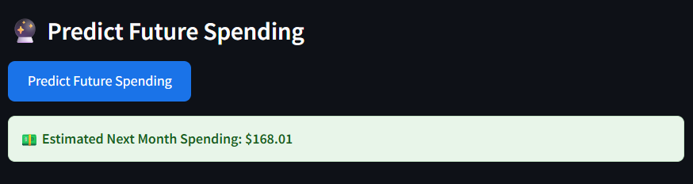
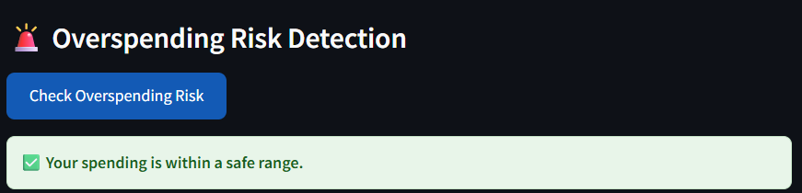
Dashboard

Slide 7
Future Improvement
• Improve model performance using hyperparameter tuning and ensemble techniques • Integrate real-time transaction data for dynamic predictions • Add smarter category-wise overspending alerts in the dashboard • Extend the dashboard into a mobile-friendly application

Slide 8

THANK YOU

